Slide 1
Machine Learning and Predicting the Age of Abalone
Kenneth Burwell-Tibbs,
Isaiah Dornelus,
Adam Abaker,
Bobbi Byrd,
Erika Johnson
July 29, 2021

Slide 2



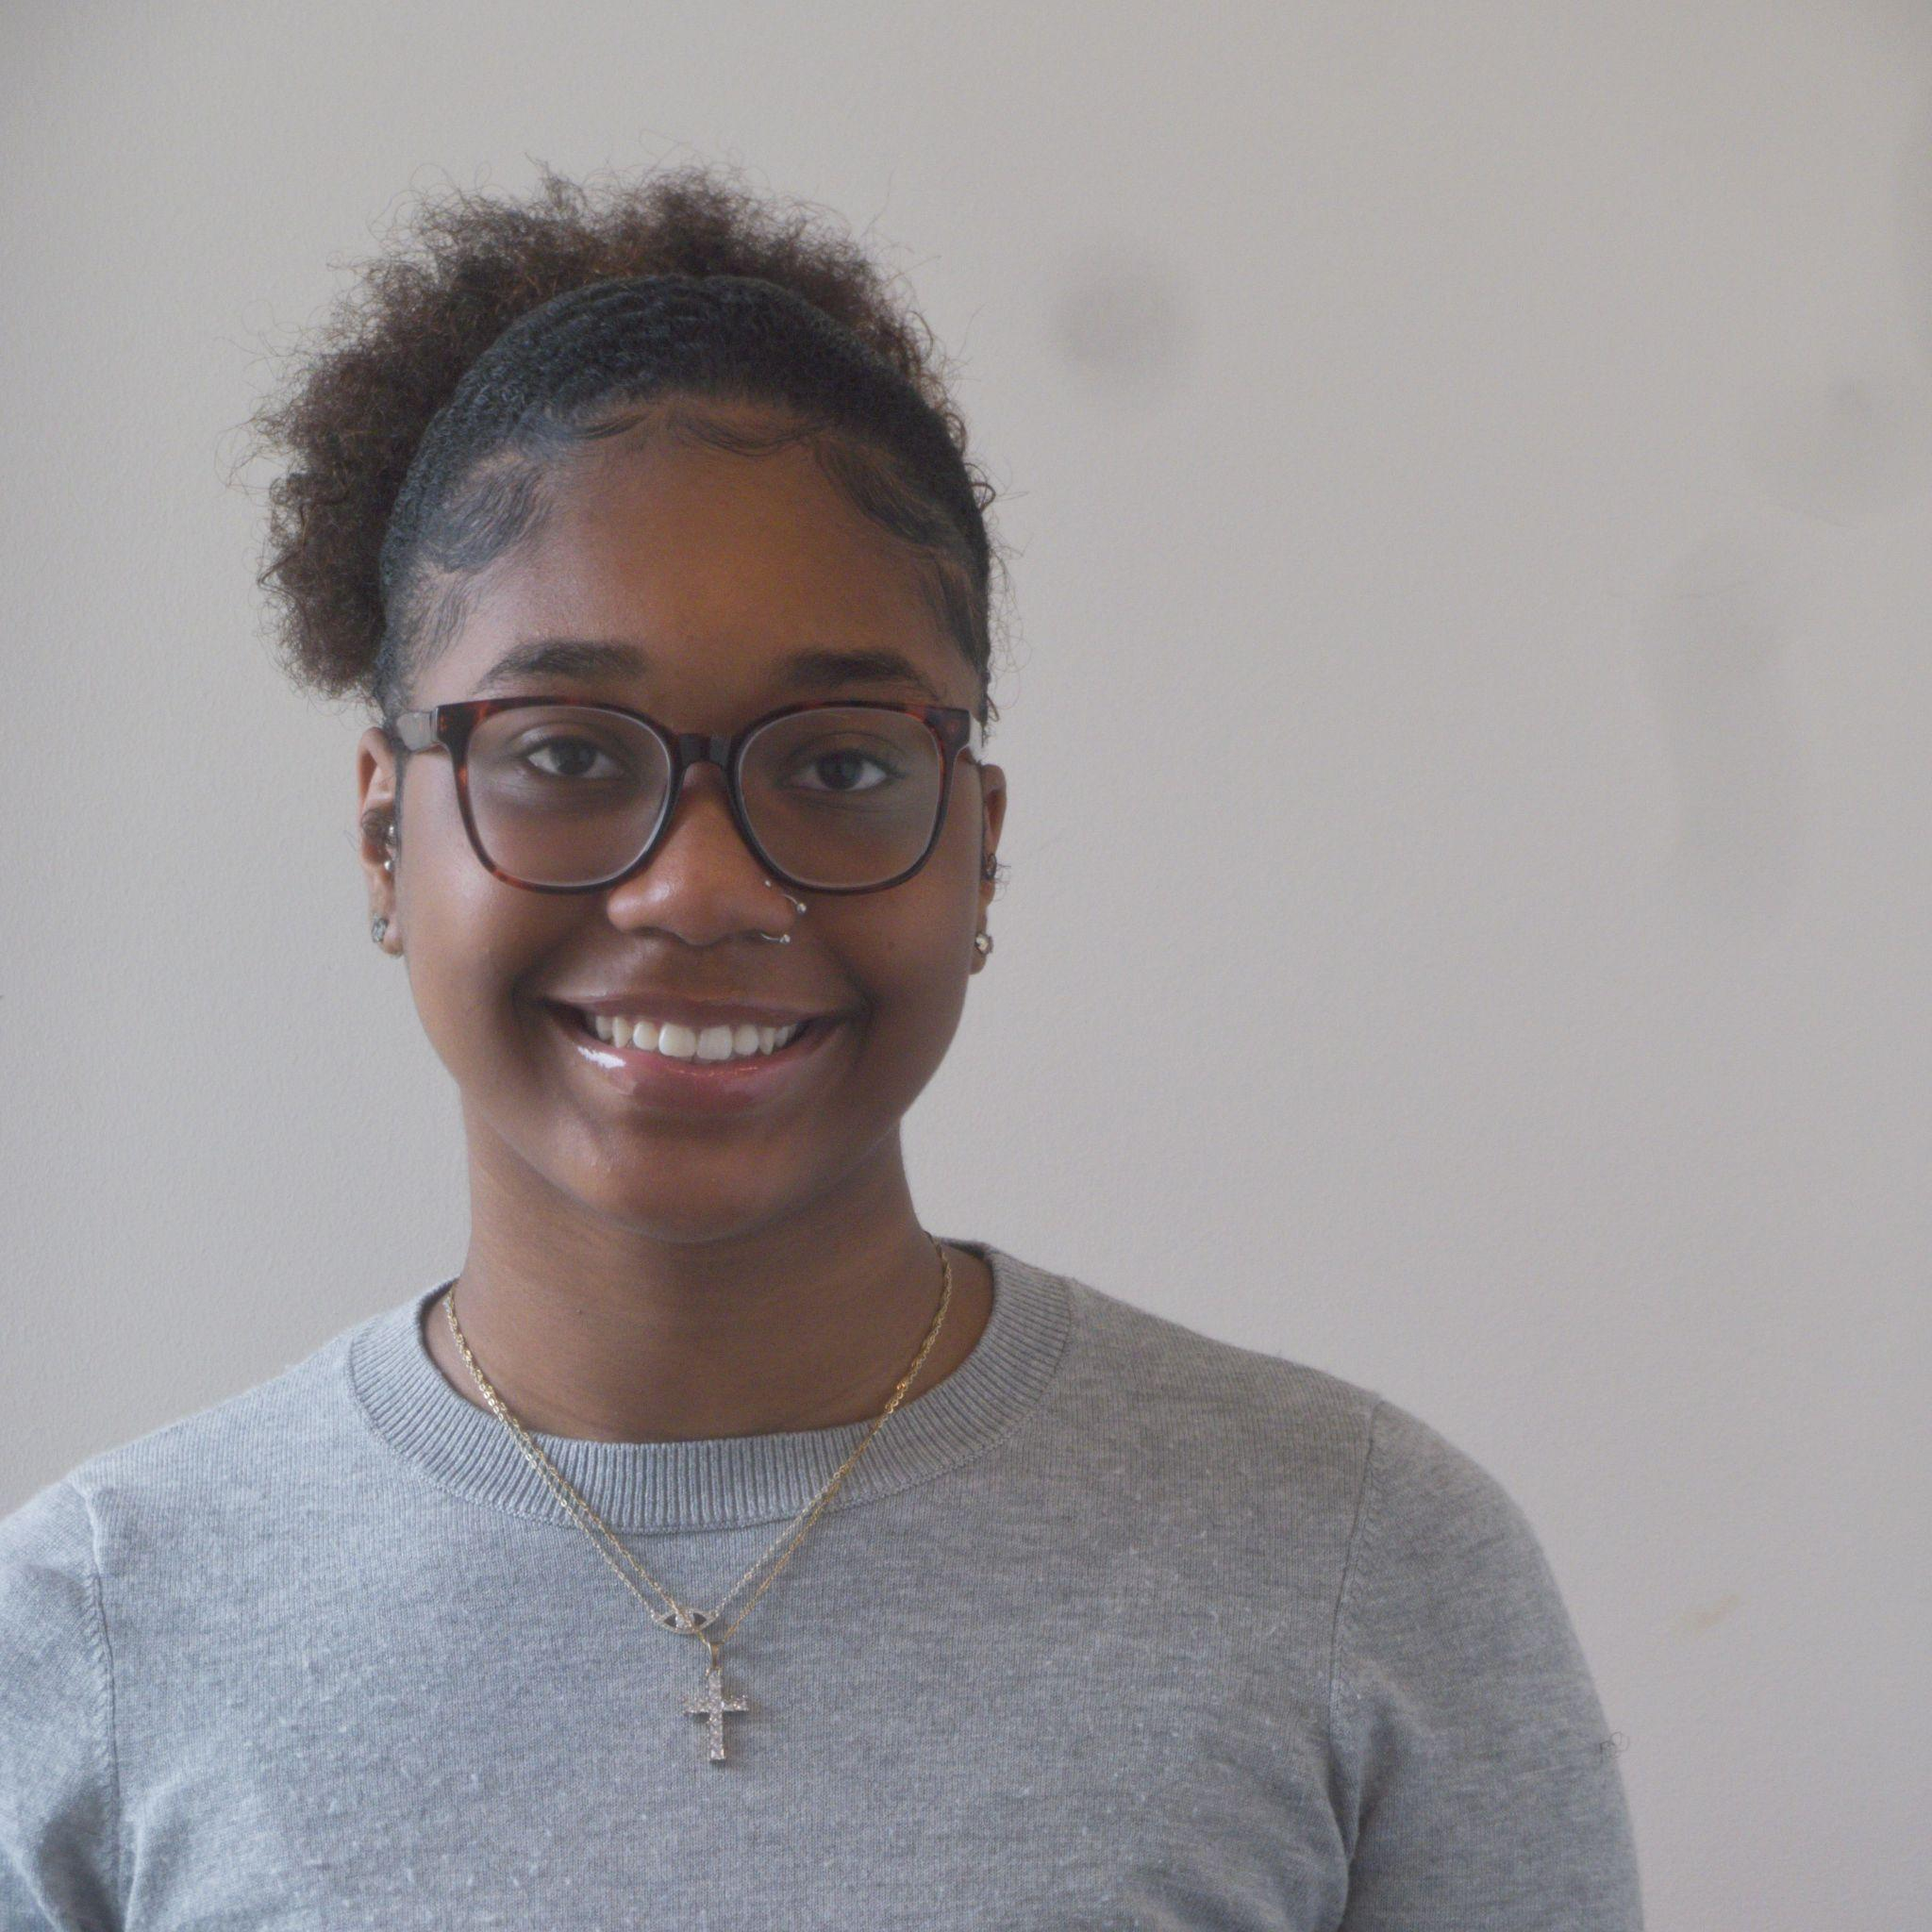

Meet the Team!
Isaiah Dornelus
Lead Code Designer
Adam Abaker
Auditor
Erika Johnson
Note Taker
Bobbi Byrd
Presentation Designer
Kenneth Burwell-Tibbs
Project Lead

Slide 3
Table of Contents
What are abalones?
Importance
Goals of the Project
Exploratory Data Analysis
Data Preparation
Models 1-5
Results
Future Research Implications
References
Questions

Slide 4
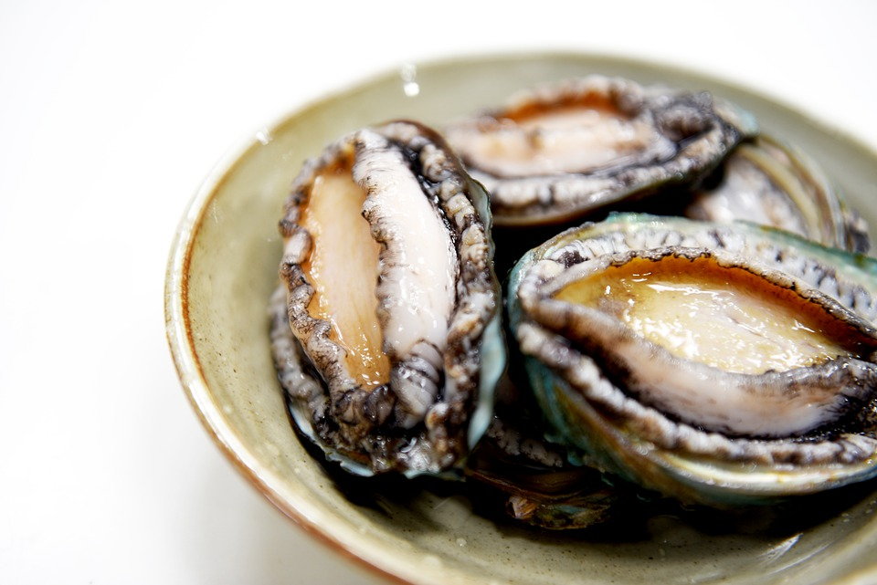
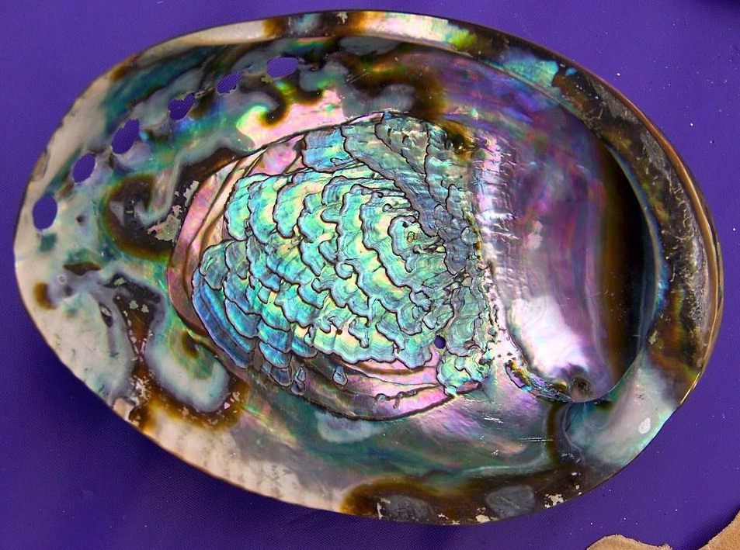
What are abalones?
Abalones are a type of marine snail fished in the Western U.S., Japan, Mexico, and Africa. They are also raised in some farms.
Abalones are considered a luxury food in places such as Southeast Asia, New Zealand, France, and Chile. Their shells can also used to make decorations or jewelry.

Slide 5
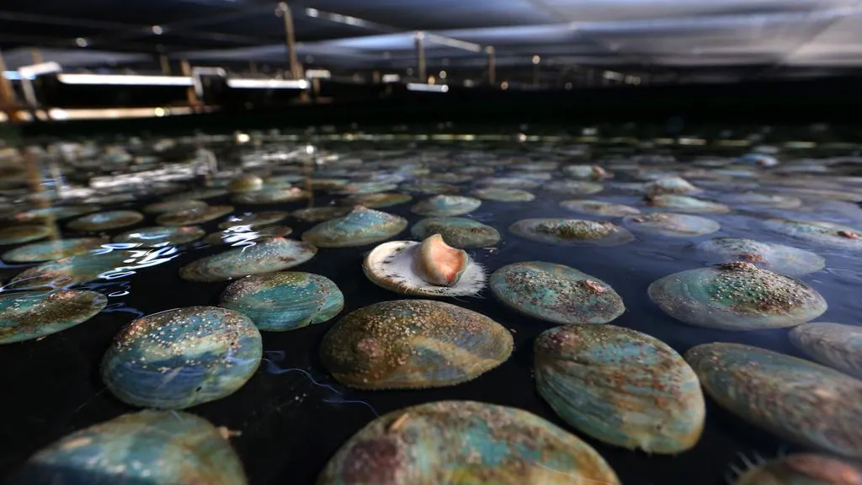
Importance
Abalones help their ecosystem(i.e grazing on kelp plants, controlling algae buildup) and are important for the economy of many places.
The abalone economic value is tied to its age.
Abalone farm

Slide 6
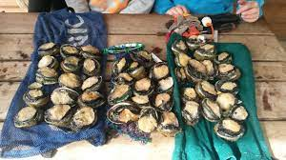
Importance (Continued)
Abalone are also endangered due to overfishing and disease.
Withering Syndrome is fatal to abalones. A bacteria causes them to starve to death. It is found near the western U.S. and Mexico.
Knowing the ages of abalones can help find where abalone are not thriving.

Slide 7
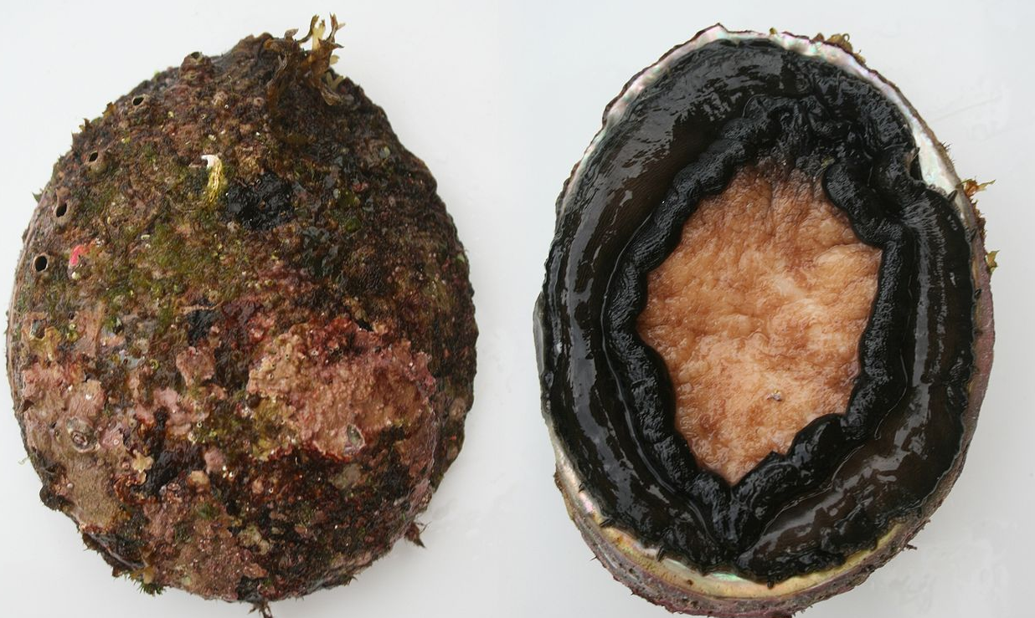
Goal(s) of the Project
An abalone’s age can be determined by cutting the shell and counting the number of rings.This method is long and expensive.
The goal of our project is create a model that determines abalone age fast, cheaply, and accurately.
We will construct a Gaussian Naive Bayes Classifier model to predict abalone age based on physical traits.

Slide 8
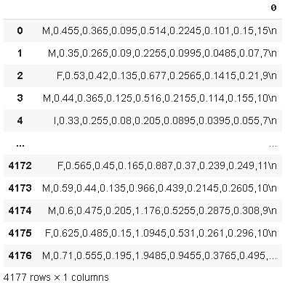
Exploratory Data Analysis
We uploaded file and converted it into a dataframe (or table).
We found that the data loaded into one column.
Every row was combined into a string (combination of characters). These needed to be separated.

Slide 9

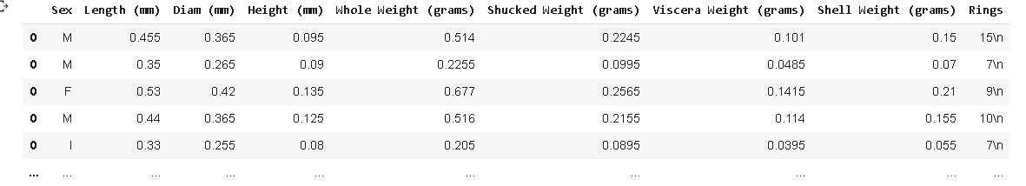
Exploratory Data Analysis (Continued)
In the top image is a value from the original data. Using a for loop, we separated each value by the commas. We then put them in separate columns of a new data frame.
Next, we took the column names from one of the files.

Slide 10

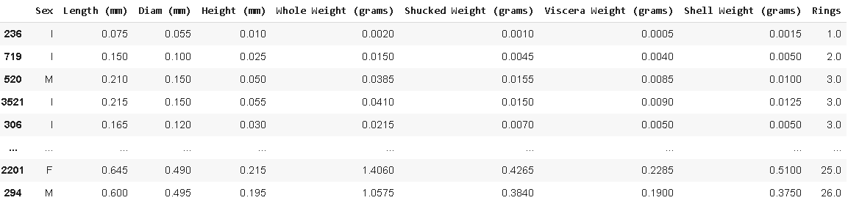
Exploratory Data Analysis (Pt. 3)
The Rings values had a ‘\n’ that needed to be removed. A for loop was used for this.
Lastly, we fixed the index values and sorted the data by the number of rings.

Slide 11

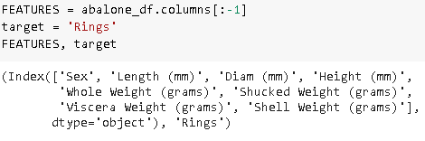
Data Preparation (Model 1)
The Sex column values were changed to numbers.
The target (y) was set as the ‘Rings’ column.
All other columns were set as the features (X) that determine the target value.

Slide 12
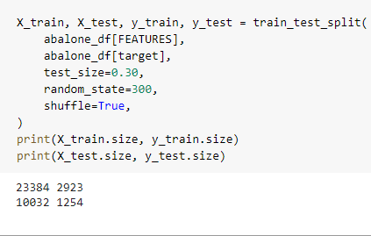
Data Preparation (Continued)
We split the data. 70% of the data. was used to train the model to predict rings.
30% of the data was used to test the model’s ability to predict the total rings.

Slide 13
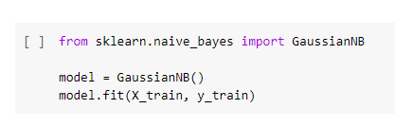


Model 1
We imported Gaussian Naive Bayes Classifier.
The data was trained using the training set.
The model predicted the testing target values using the testing features.
The accuracy of the model was low.

Slide 14
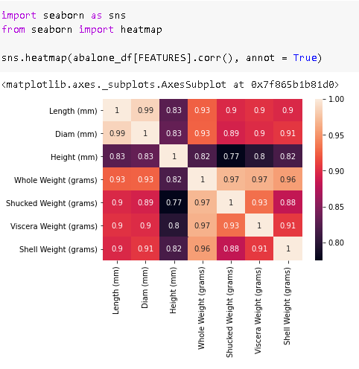
Model 2
We made a correlation heatmap of the feature columns.
Some columns had a correlation near 1 (which makes values dependent on one another)

Slide 15

Model 2 (Continued)
We selected 4 dependent features. We made an array of them to remove.
There was a small accuracy difference compared to model 1.

Slide 16
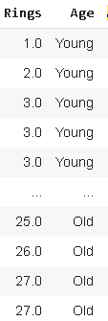
Model 3
Abalones were grouped by their number of rings. Features stayed the same as model 1
Young abalones have less than 5 rings.
Middle age abalones have 5 to 15 rings.
Old abalones have more than 15 rings.

Slide 17
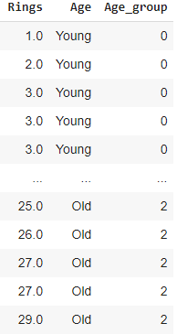
Model 3 (Continued)
The new target is a number key for the different ages (Age column).
Young abalone are in Age_group 0, Middle Age is 1, and Old is 2.
The accuracy greatly increased compared to the first 2 models.

Slide 18

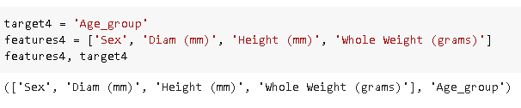
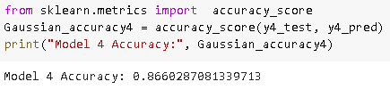
Model 4
This combines the ideas for models 2 and 3.
The reduced features from model 2 were used.
The new target column from model 3 was used.
Model 4 had an increased accuracy from model 3 (86%).

Slide 19
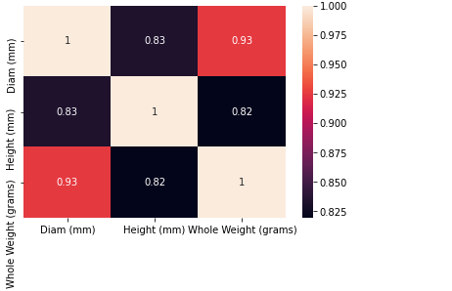

Model 5
The first thing done for the last model was correlation heatmap of model 4’s features.
We took out 1 more feature from model 4.
The accuracy increased to 91%.

Slide 20
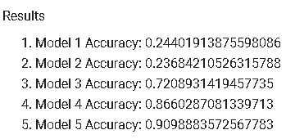
Results
The first 2 models can not predict a precise age due to too many unique (target) values.
Cutting down the number of groups or target values made the predictions more accurate.
We also found that removing features with a high correlation had the same effect with fewer groups.
In conclusion, these two factors gave model 5 the highest accuracy of about 91%.

Slide 21
Future Research Implications
This research can be used to gauge the ages of other animals who are endangered. Understanding how long the population is living gives a sign of where actions are needed to save the animal.
Perhaps our research could assist the medical field, as abalone can provide several health benefits as well.
This research may also be applied in restaurants to determine the price and quality of abalone before purchases.

Slide 22
References
https://www.britannica.com/animal/abalone
https://wildlife.ca.gov/Conservation/Laboratories/Shellfish-Health/Abalone-Diseases

Slide 23
Questions?

